Slide 1
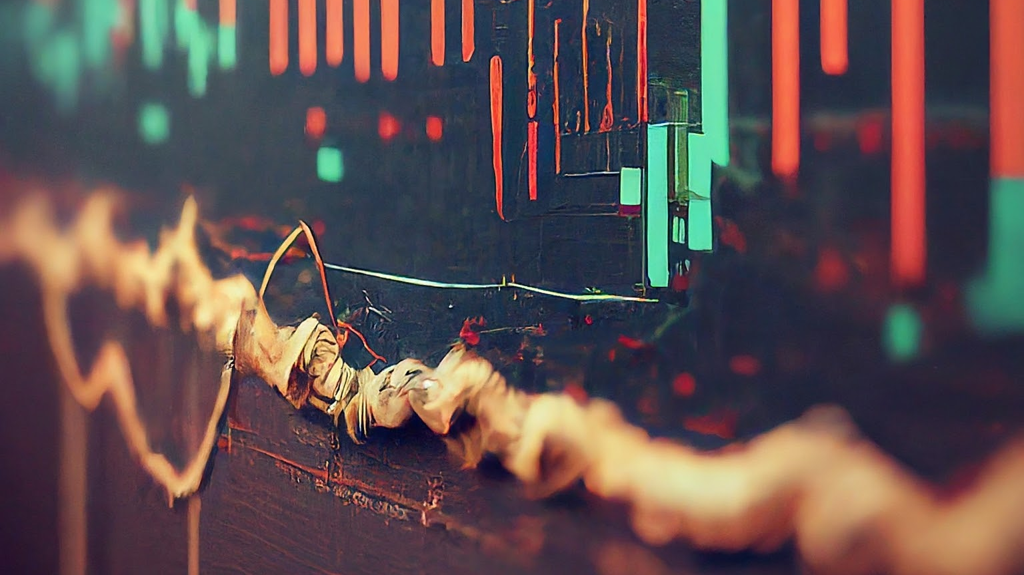
An Analysis of Expert Advisor
AI and ML Bootcamp
Group Project 2
Group 2

Slide 2
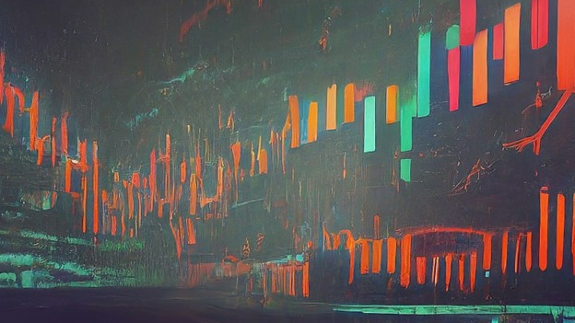
Algorithmic Trading Systems Workflow
1. Develop the hypothesis
Run the EA as intended
Format and clean data
Analyze performance metrics

Slide 3

Algorithmic Trading Systems Workflow
2. Run experiments on different assets
Develop a function that forecasts volatility
Run Expert Advisor on volatile stocks
Analyze Performance Metrics

Slide 4

Algorithmic Trading Systems Workflow
3. Validate or invalidate hypothesis
Review all data
Visualize
Formulate conclusion

Slide 5

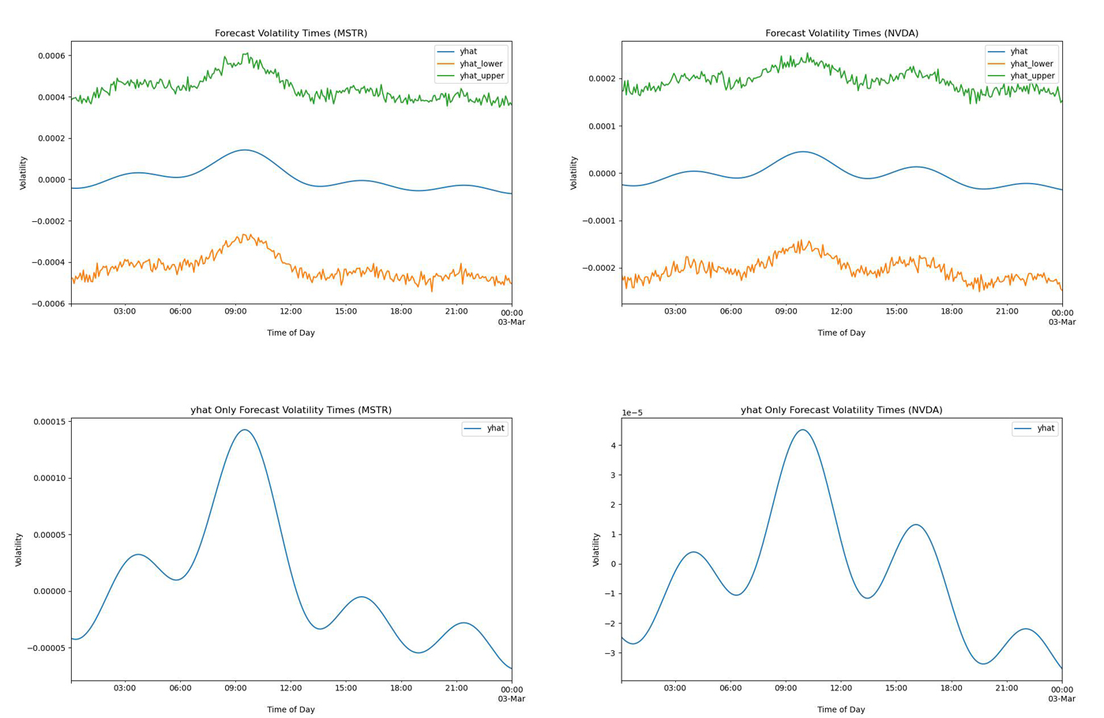
Prophet Analysis

Slide 6

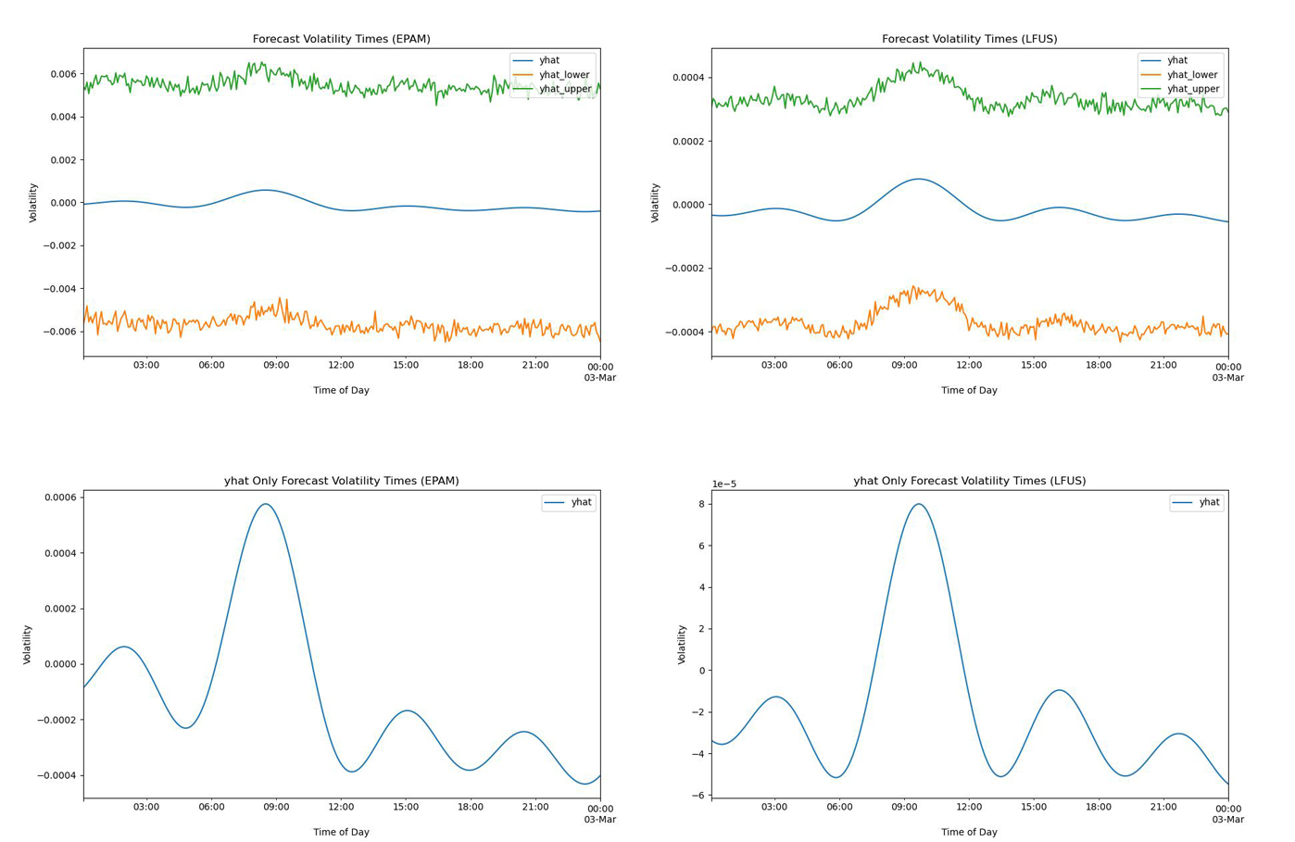
Prophet Analysis

Slide 7

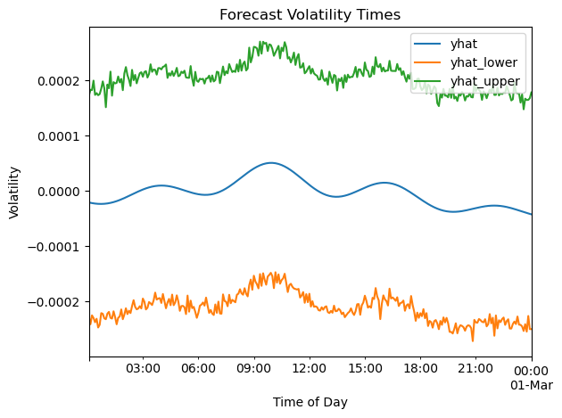
NVIDIA Forecast

Slide 8
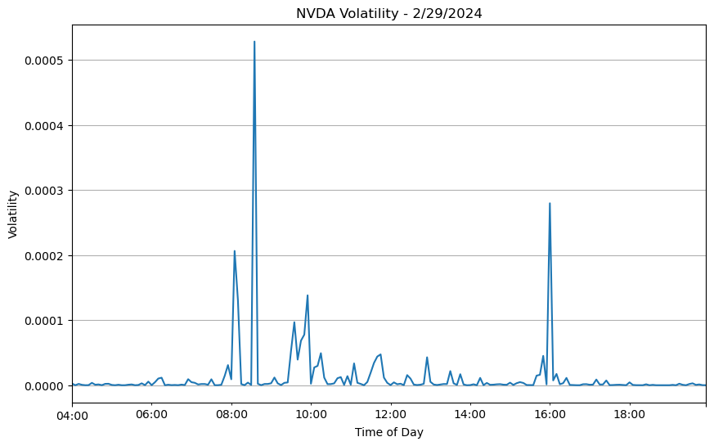
NVIDIA Actual

Slide 9

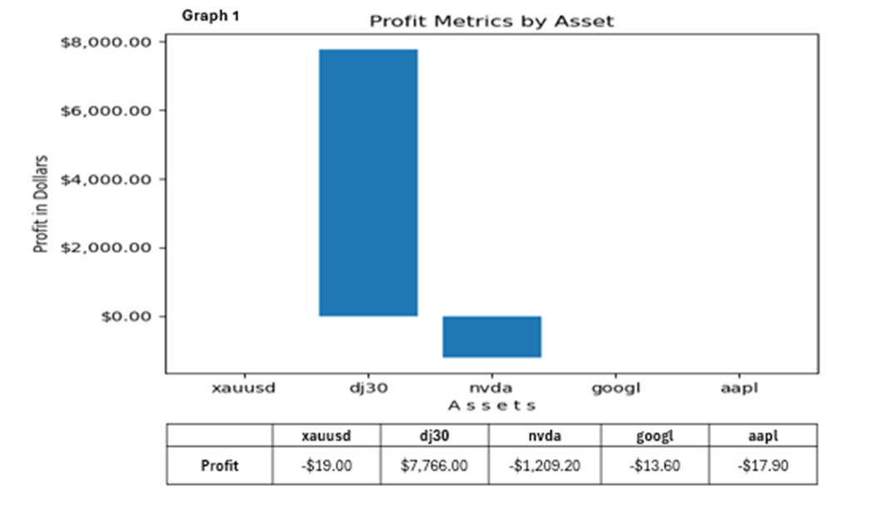
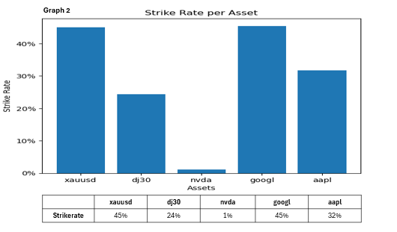

Slide 10

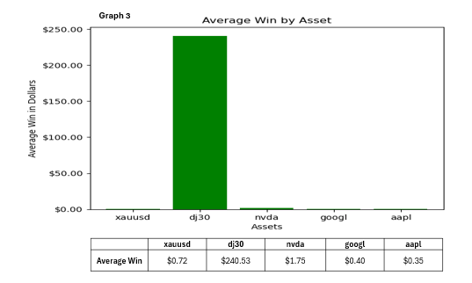
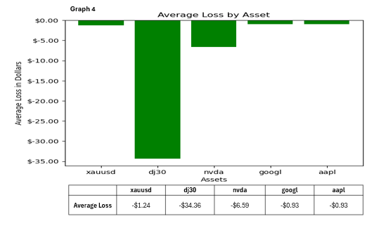

Slide 11

Where are we going with all this?

Slide 12
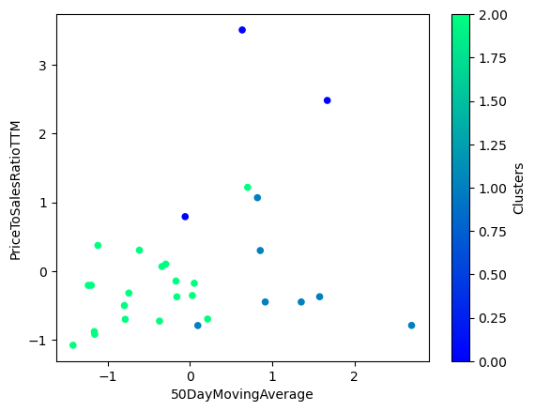
Price to Sales – 50 Day Moving Average

Slide 13

Conclusions:
Expert Advisor did not show a profit when analyzing the assets we chose.
WHY?
Stocks we chose were not volatile enough?
Stocks we chose were not in a specific price range?
EA needed more time to learn the habits/patterns of these assets?
EA was truly designed to work only on the US30 Index?
Our sampling of assets was just too small for EA to function properly?

Slide 14
Problems Encountered:
Not all of us understand enough about the stock market
Not all of us are as familiar with EA as we would have liked
Were not sure how best to evaluate EA’s success with new assets
Volatility times for chosen stock occurred once a day, so only one chance each day to run your analysis
Not enough time to test the volume data as we liked

Slide 15
Ethics Concerns
If Expert Adviser and others like it were perfected:
Would they reshape the stock market?
Would likely lead to:
market efficiency
educed volatility
potential liquidity concerns
disruption of traditional trading strategies
This is likely to necessitate regulatory adjustments.

Slide 16
With More Time:
Interview the authors of Expert Advisor for predictions in advance, then thoughts on our conclusions.
Done more ML on US30 to understand characteristics of those specific stocks.
Used our ML findings to choose assets for us to analyze.
Create our own version of Expert Advisor to work on other assets.

Slide 17
Questions?

Slide 18
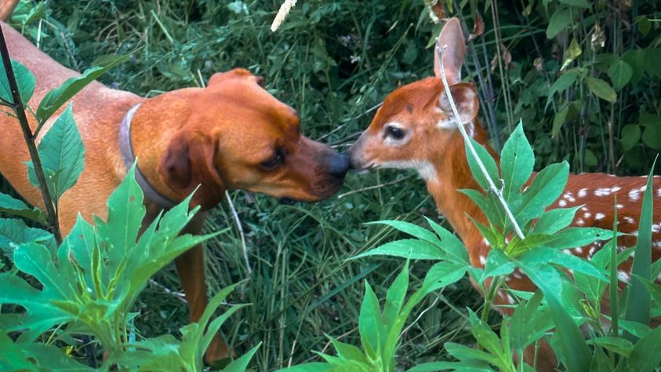
Thank you for watching our Presentation!
Farzana Azad-Hussain
Marnie Brannon
James Dreussi
Antonio Smith

